Slide 1


Fake News Detection Website
PRESENTED BY
NAME : TEJA TARAPATLA
STUDENT ID : 811294564

Slide 2
Project Overview
This project focuses on developing an advanced fake news detection system that combines the power of deep learning with a user-friendly web interface. The core of the system is an LSTM (Long Short-Term Memory) model, a type of recurrent neural network particularly effective for sequence-based data like text. By leveraging this robust classification algorithm, the project provides accurate and reliable predictions about the authenticity of news content.
The web-based application serves as an accessible platform where users can interact with the detection system. Users have the flexibility to input news headlines, full articles, or even upload files (like CSVs) containing multiple articles. The system processes the input in real time and predicts whether the content is classified as "real" or "fake."

Slide 3
Objectives
Develop a web application for detecting fake news.
Integrate a trained LSTM model for real-time predictions.
Provide a user-friendly interface for input and results.
Enable scalability and accessibility for broader usage.

Slide 4
Features
Real-time fake news prediction.
Simple text input for news headlines or articles.
User-friendly results display with confidence scores.
Support for uploading files (e.g., CSVs of news articles).
Interactive visualizations for insights.

Slide 5
Technology Stack
Backend - Flask or FastAPI for serving the ML model.
Frontend - HTML, CSS, JavaScript (or frameworks like React).
Machine Learning - TensorFlow/Keras for the LSTM model.
Deployment - AWS, Google Cloud, or Azure for hosting.
Database - SQLite or MongoDB for storing user inputs and logs.

Slide 6
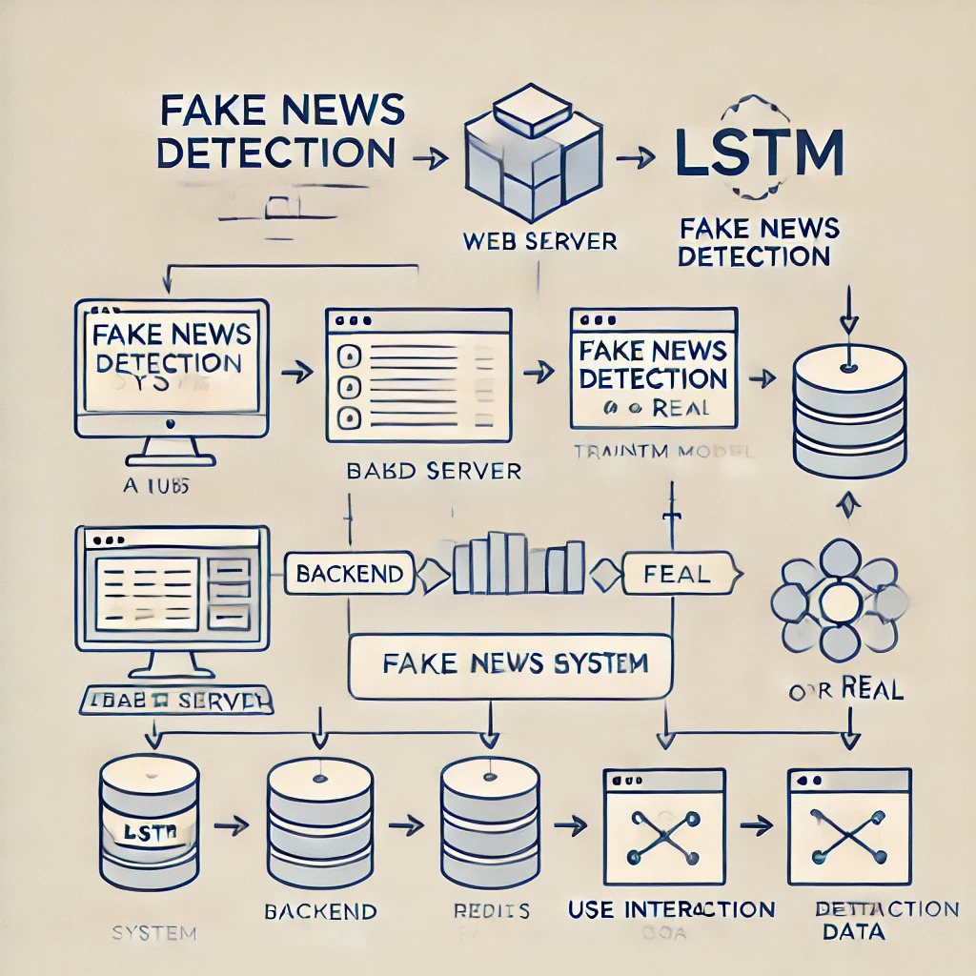
Architecture

Slide 7
Deployment
Monitoring : Use tools like Prometheus or CloudWatch for application monitoring.
Cloud Hosting : Deploy the web application on AWS/Google Cloud/Azure.
Model Optimization : Use TensorFlow Serving or TorchServe for efficient model inference.
Scalability : Implement load balancing and auto-scaling.

Slide 8
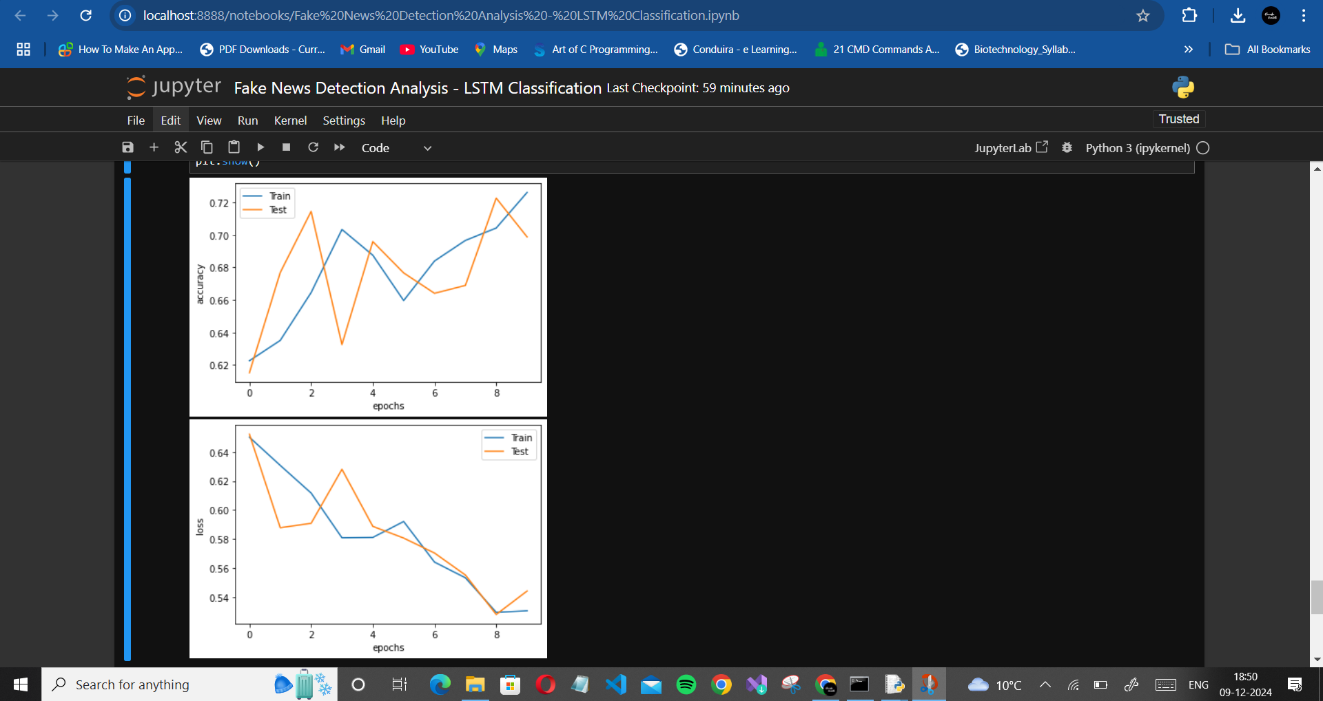
EVALUATION

Slide 9
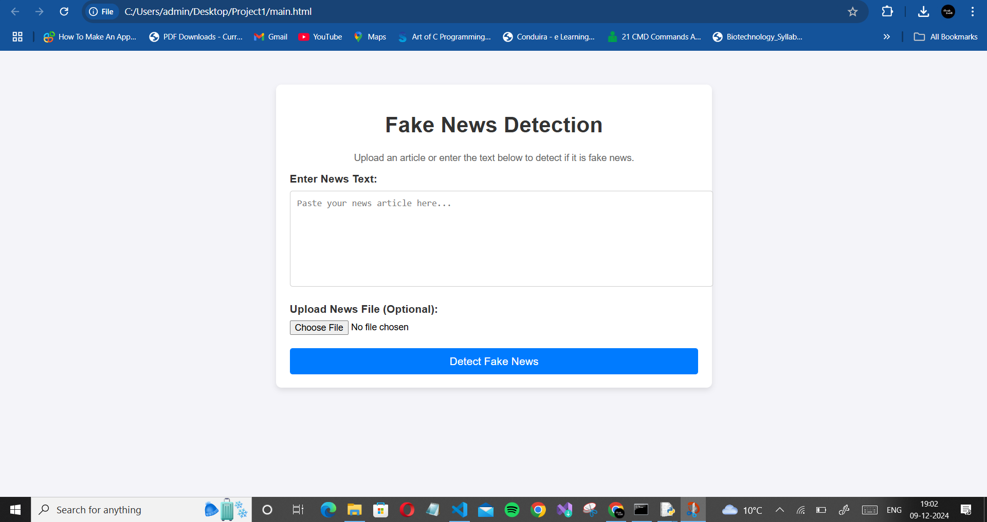
RESULTS

Slide 10
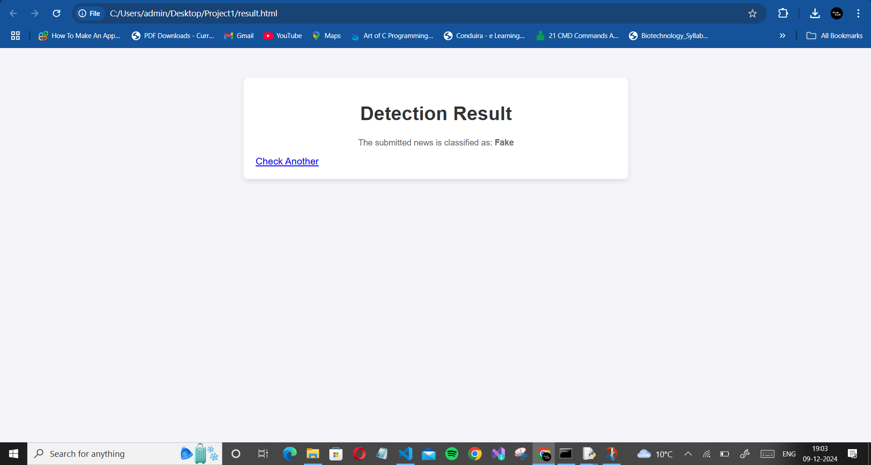
RESULTS
We can observe that when the user inputs some news which is not really true the application gives the output as below,

Slide 11

RESULTS
Now, we can observe the output when some true news or articles are inputted,

Slide 12
CONCLUSION
The Fake News Detection project effectively applies deep learning, specifically LSTM networks, to tackle the pervasive issue of misinformation. By employing a robust data preprocessing pipeline and advanced text analysis techniques, the system reliably classifies news articles as real or fake. Its integration into a user-friendly web application enables real-time predictions, batch processing, and confidence score visualization, making it accessible to a wide audience, including individuals, organizations, and researchers. With a scalable and deployment-ready design, the project lays the groundwork for addressing misinformation across journalism, education, and social media. Future enhancements, such as multilingual support and hybrid models, can further broaden its scope and impact, showcasing the transformative potential of AI in fostering trust in information systems.

Slide 13
Future work
Enhance model accuracy with hybrid approaches (e.g., combining LSTM with BERT).
Add support for multiple languages using pre-trained multilingual models.
Include sentiment analysis for additional insights.
Develop a mobile app for on-the-go fake news detection.

Slide 14
THANK YOU !

